Slide 1


Training Deck
Agenda:
Events in Lightning Component
Error handling in Lightning Component

Slide 2
Types of Events
Browser Event
Framework Event
Component Event
Application Event
System Event
Init
Change
etc.

Slide 3
Browser Events
A notification by the browser regarding an action
Browser events are handled by client-side JavaScript controllers
The following button is wired up to a browser onclick event in response to a button click. Clicking the button invokes the handleClick method in the component’s client-side controller.
<lightning:button label = "Click Me" onclick = "{!c.handleClick}" />
Link: https://developer.salesforce.com/docs/atlas.en-us.lightning.meta/lightning/events_and_actions.htm

Slide 4
Component Event
Component Event is applicable when components are in the containment hierarchy.
Following steps need to be followed to implement Component Events.
Create Custom Component Event - Create a custom component event using the <aura:event> tag in a .evt resource. Events can contain attributes that can be set before the event is fired and read when the event is handled.
Fire Component Events - Fire a component event to communicate data to another component. A component event can be handled by the component that fired the event or by a component in the containment hierarchy that receives the event.
Handling Component Events - A component event can be handled by the component that fired the event or by a component in the containment hierarchy that receives the event.
Link: https://developer.salesforce.com/docs/atlas.en-us.lightning.meta/lightning/events_component_example.htm

Slide 5


Create Custom Component Event
Use type="COMPONENT" in the <aura:event> tag for a component event.
The component that fires an event can set the event’s data. To set the attribute values, call event.setParam() or event.setParams().
Link: https://developer.salesforce.com/docs/atlas.en-us.lightning.meta/lightning/events_component_create.htm

Slide 6

Fire Component Events
A component registers that it may fire an event by using <aura:registerEvent> in its markup.
To get a reference to a component event in JavaScript, use component.getEvent("evtName") where evtName matches the name attribute in <aura:registerEvent>.
Use fire() to fire the event from an instance of a component.
Link: https://developer.salesforce.com/docs/atlas.en-us.lightning.meta/lightning/events_component_fire.htm

Slide 7
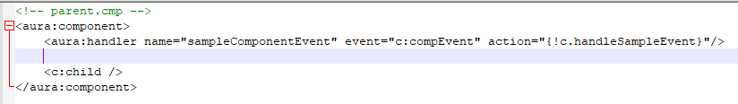
Handling Component Event
Parent component handles the event fired from the child component.
Link: https://developer.salesforce.com/docs/atlas.en-us.lightning.meta/lightning/events_component_handling_child.htm

Slide 8
Application Event
Application events follow a traditional publish-subscribe model. An application event is fired from an instance of a component. All components that provide a handler for the event are notified.
Following steps need to be followed to implement Application Events.
Create Custom Application Events - Create a custom application event using the <aura:event> tag in a .evt resource. Events can contain attributes that can be set before the event is fired and read when the event is handled.
Fire Application Events - Application events follow a traditional publish-subscribe model. An application event is fired from an instance of a component. All components that provide a handler for the event are notified.
Handling Application Events - Use <aura:handler> in the markup of the handler component.
Link: https://developer.salesforce.com/docs/atlas.en-us.lightning.meta/lightning/events_application_example.htm

Slide 9
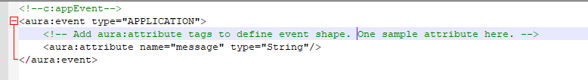

Create Custom Application Events
Use type=“APPLICATION" in the <aura:event> tag for a component event.
The component that fires an event can set the event’s data. To set the attribute values, call event.setParam() or event.setParams().
Link: https://developer.salesforce.com/docs/atlas.en-us.lightning.meta/lightning/events_application_create.htm

Slide 10

Fire Application Events
A component registers that it may fire an event by using <aura:registerEvent> in its markup.
The name attribute is required but not used for application events. The name attribute is only relevant for component events.
Use $A.get("emyNamespace.:myAppEvent") in JavaScript to get an instance of the myAppEvent event in the myNamespace namespace.
The syntax to get an instance of an application event is different than the syntax to get a component event, which is component.getEvent("evtName").
Use fire() to fire the event.
Link: https://developer.salesforce.com/docs/atlas.en-us.lightning.meta/lightning/events_application_fire.htm

Slide 11

Handling Application Event
Use <aura:handler> in the markup of the handler component.
Link: https://developer.salesforce.com/docs/atlas.en-us.lightning.meta/lightning/events_application_handling.htm

Slide 12
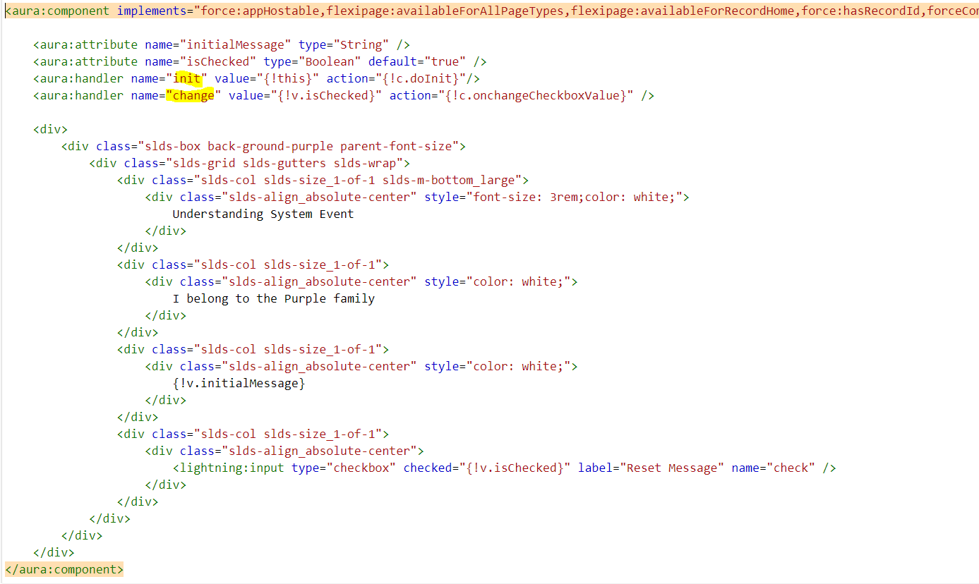
System Events
“init” and “change” are the most frequently used System Events.
“init” gets fired automatically when a component gets loaded.
“change” event is fired, if an attribute value gets changed.

Slide 13
Quiz
How many types of events have we learnt today?
How many types of Framework event do we have?
Can we call server-side controller in “init” event handler?

Slide 14
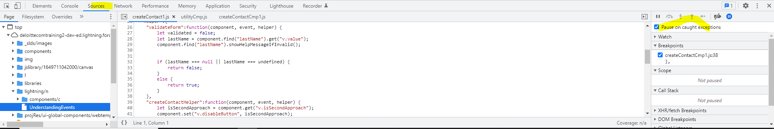
Error Handling in Client Side
Use try-catch block
To debug an issue from the client side, we can –
Inspect the browser
Go to “source” tab and debug the code

Slide 15


